Slide 1
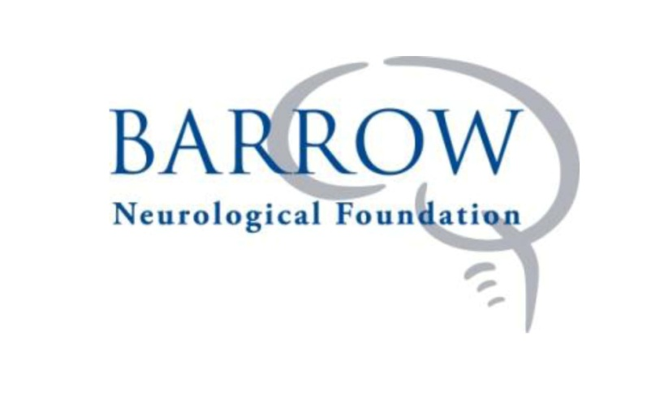
The Philosophy, Approach, and Benefits of the Philanthropic Conversation with Your Clients
Presented to: Sioux Falls Estate Planning Council
Brian Mortenson
CEO / President
St. Joseph’s Foundation
Barrow Neurological Foundation
Thursday, May 21, 2015

Slide 3
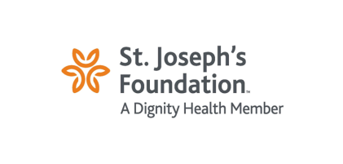
Key Findings from the U.S. Trust Study:
Advisors and clients disagree about the focus of their philanthropic conversations. Advisors believe their philanthropic discussions are equally balanced between their clients’ personal goals/interests and technical topics, but most consumers say their advisors primarily focus on the technical aspects of giving, including tax consequences. Consumers want advisors to adopt a more balanced approach, focusing on both their personal passions/charitable interests and technical topics.

Slide 4
Key Findings from the U.S. Trust Study:
Less than half of consumers are fully satisfied with the philanthropic conversations they have with advisors, likely influenced by the disparity between advisor focus and client desires.

Slide 5
Key Findings from the U.S. Trust Study:
Most advisors say discussing philanthropy with their clients is good for their business development.

Slide 6
Key Findings from the U.S. Trust Study:
While advisors correctly report their clients’ top motivations to give (personal passion, a desire to give back/make an impact), they overestimate the importance of tax benefits and enhancing the family name/business, while underestimating the desire to encourage future generations in philanthropy.

Slide 7
Key Findings from the U.S. Trust Study:
One-third of advisors say they initiate philanthropic discussion with their clients; however, far fewer consumers say that their advisor brings up the subject on their own.

Slide 8
Seven Things to be Mindful of in the Philanthropic Conversation with Your Clients

Slide 9
Take Your Shoes Off!

Slide 10
The Thompson Experience
A values-based estate plan will answer your biggest concerns:
Do I have enough to live on for the rest of my life?
How can I provide for my spouse, children, and grandchildren?
How can I give to my heirs in responsible and relevant ways?
How can I self-direct the portion of my estate that must be used for the greater good of society, commonly collected as taxes?

Slide 11
Understand and do not minimize the trust placed in you by your clients

Slide 12
Are your clients already philanthropists, or would they like to be?

Slide 14
View tax benefits for what they are:
- May enhance size of gift and/or expedite timeline
- May re-direct “social capital” allocation
- Generally not a primary motivator

Slide 15
A picture paints a thousand words!

Slide 16
Life Estate Reserved
This illustration is offered as a service.
Please feel free to call for further assistance.
_________________________________________________________________________________________________________________________

Slide 19
Charitable Unitrust
This illustration is offered as a service.
Please feel free to call for further assistance.
_________________________________________________________________________________________________________________________

Slide 23
UT and Insurance Trust
This illustration is offered as a service.
Please feel free to call for further assistance.
_________________________________________________________________________________________________________________________

Slide 27
Encourage engagement of the charity to better serve the client
Recognition and thanks
Directed interest
May well be the culmination of an extended relationship

Slide 29
Honor the principle of perpetuation
Lifetime giving patterns to be continued
Deeper meaning in the face of mortality and legacy

Slide 30
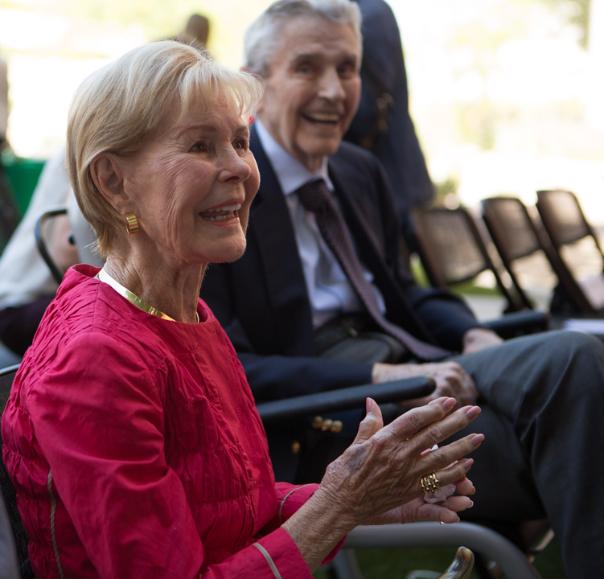
John and Doris Norton

Slide 32
Thank You!

